Slide 1
Test Scaffolding
Giuseppe Scanniello
Simone Romano
Michelangelo Esposito

Slide 2

Test Scaffolding
Any code used to facilitate testing activities
It is not part of the “product” as seen by the end user
It includes test drivers and test doubles

Slide 3
Purpose of test scaffolding
Increase controllability and observability
Controllability: ability to affect the system behavior (in particular, replicate that behavior)
How easy it is to provide a system with the needed inputs, in terms of values, operations, and behaviors
Observability: ability to observe the system behavior
How easy it is to observe the behavior of a system in terms of its outputs, effects on the environment, and other hardware and software components
Dependencies make controllability and observability difficult

Slide 4
How to affect the behavior of the SUT?
The behavior of the SUT---System Under Test---can be affected directly, i.e., via its "front door" (e.g., public API), or indirectly, i.e., via its "back door"
Direct inputs
Values a test inject into the SUT via its front door
Indirect inputs
When the behavior of the SUT is affected by the values returned by another component whose services it uses, we call these values indirect inputs of the SUT

Slide 5
How to observe the behavior of the SUT?
The behavior of the SUT can be observed thanks to its direct or indirect outputs
Direct outputs
Responses a test receives from the SUT via its front door
Return values of method calls, updated arguments passed by reference, exceptions raised, …
Indirect outputs
When the behavior of the SUT includes actions that cannot be observed through the public API of the SUT but which are seen/experienced by other components, we call these actions indirect outputs of the SUT
Method calls to another component, messages sent on a message channel, records inserted into a database/file, …

Slide 6
Testability
The degree to which a system facilitates the establishment of test criteria, and the performance of tests, to determine whether these criteria have been met
How hard it is to find faults in a system
Low controllability and observability implies low testability

Slide 7
Test driver
A component that replaces the calling component of a CUT---Component Under Test
A test method implements a driver since it replaces the actual calling component
Test driver
Calls
CUT

Slide 8
Test double
A component that replaces a component (aka depended-on component---DOC) on which the CUT depends
CUT
Calls/depends on
Test double

Slide 9
When should I use test doubles?
DOCs not available yet at testing time
E.g., I have to test a CUT A that depends on a component B, however B has not been implemented yet; in order to test A, I replace B with a test double (e.g., a stub)
DOCs too expensive in terms of time or resources so it is preferable to avoid their use during unit testing
Make test execution deterministic so removing side effect due to DOCs
...

Slide 10
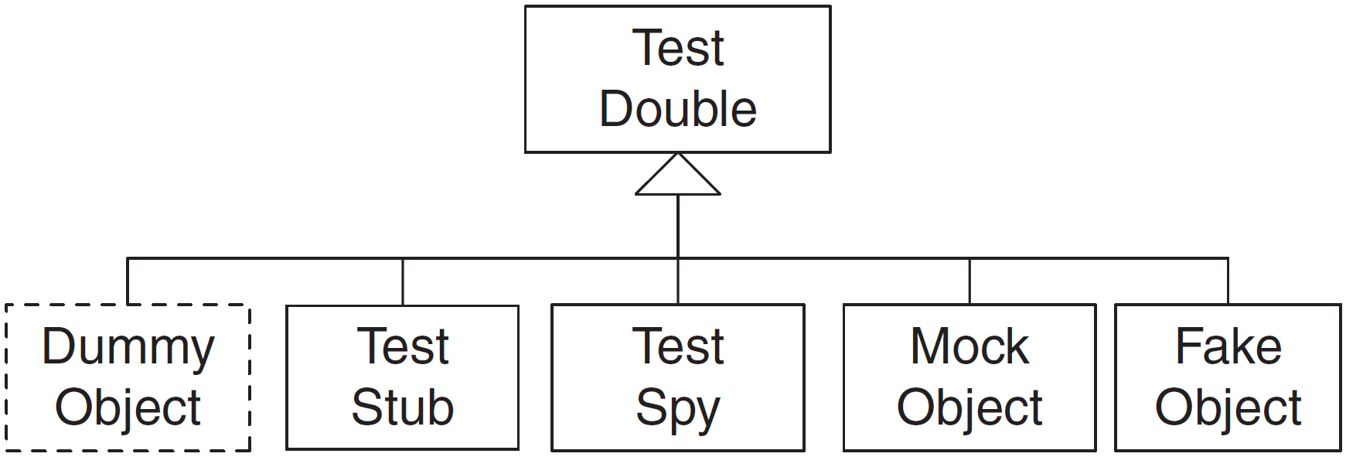
Taxonomy of test doubles
It has been proposed by Gerard Meszaros [2007]

Slide 11
Dummy object
A replacement for an object that, although required, is never used by the CUT
E.g., a dummy object can be used to fill the parameter list of a method where a parameter is never used
It does nothing, i.e., its methods have either no implementation or just throw an exception if called

Slide 12
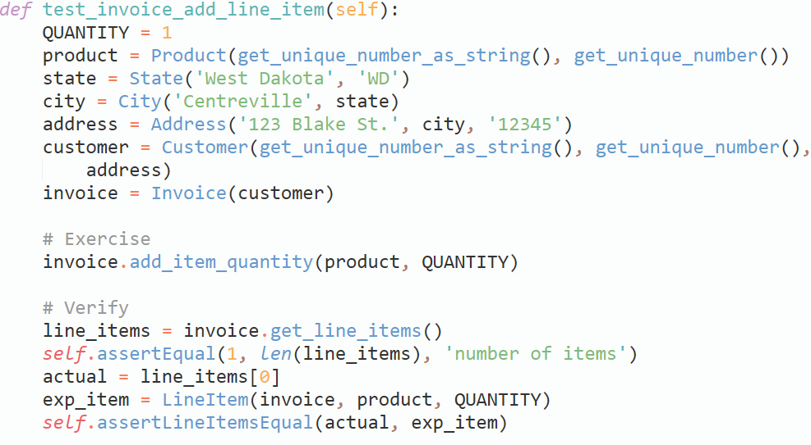
Motivating example for a dummy object
A lot of code needed just to set up the fixture
A Customer object is required but never used

Slide 13
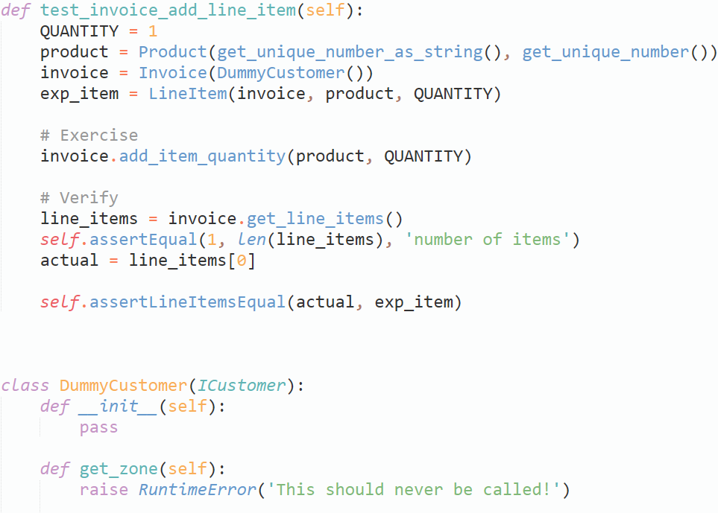
Solution with a dummy object
Simpler fixture
Dummy object as parameter
Dummy object implementation

Slide 14
Test stub
A replacement for a DOC that injects the desired indirect inputs into the CUT
It enables the control of the indirect inputs
A test stub used to inject valid indirect inputs is a responder
A responder test stub is used in happy path testing
A test stub used to inject invalid indirect inputs is a saboteur
It returns unexpected values\objects or raises exceptions
A test stub that replaces a DOC not yet available is called temporary
Once the actual DOC is available it replaces the temporary test stub

Slide 15
Test stub
Two ways of implementing a test stub:
Hard-coded test stub
It returns hard-coded values
It is purpose-built for a single test or a very small number of tests
Configurable test stub
It allows avoiding building a different hard-coded test stub for each test
Need of configuring its behavior in the fixture setup phase

Slide 16
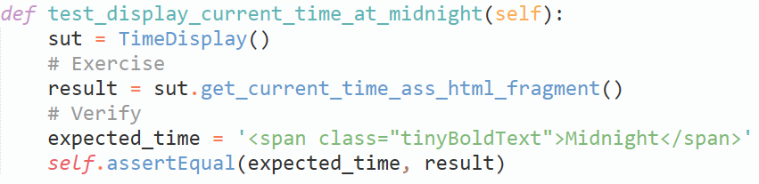
Motivating example for a responder
It verifies an HTML string containing the current time at midnight---unfortunately, this test rarely passes because it depends on the real system clock

Slide 17
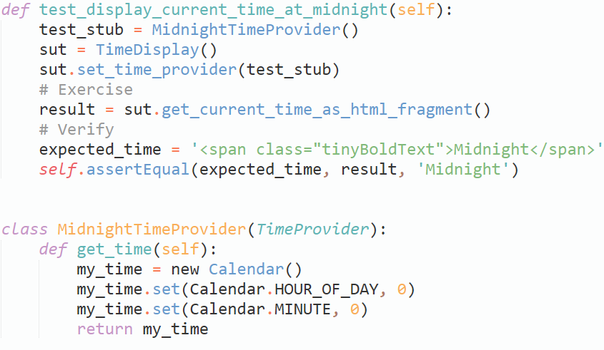
Solution with an hard-coded responder
Test stub configuration
Test stub installation
Test stub implementation

Slide 18
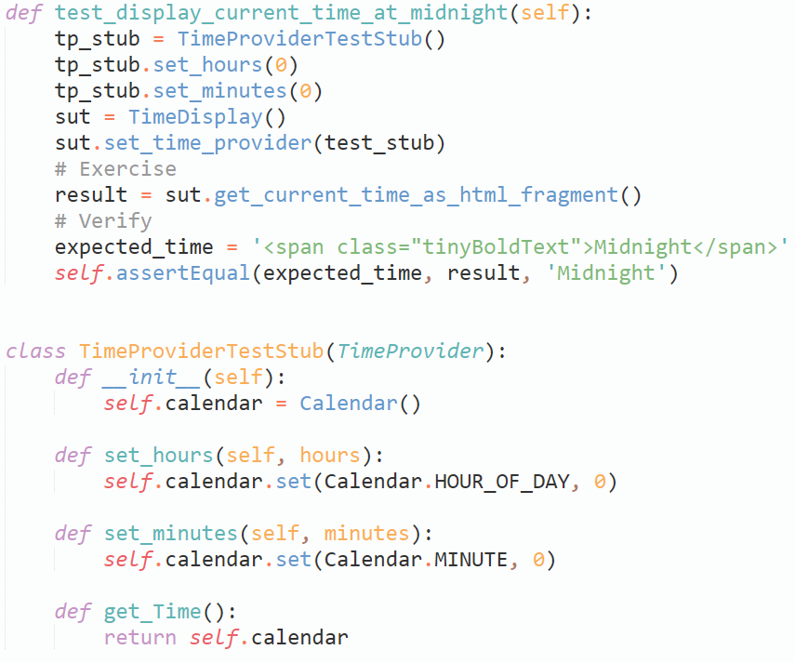
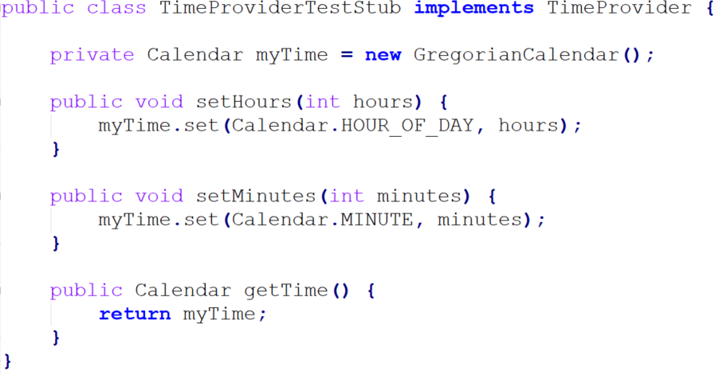
Solution with a configurable responder
Test stub configuration
Test stub installation
Test stub implementation

Slide 19
Test spy
It can be seen as a more sophisticated test stub with some recording capabilities
When testing a CUT, it also enables the observation of the indirect outputs
It replaces a DOC and records the calls to its methods when it is exercised by a test, then that test compares the actual values recorded by the test spy with the expected values
It can be implemented in either an hard-coded or configurable way
Notes:
Similar to a test stub

Slide 20
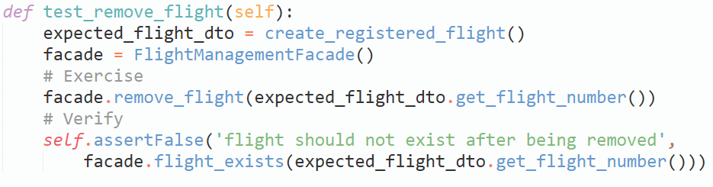
Motivating example for a test spy
It verifies the removal of a flight but does
not verify the indirect outputs---i.e., the fact that a DOC is expected to log each time a flight is removed along with the date and username of the requester

Slide 21
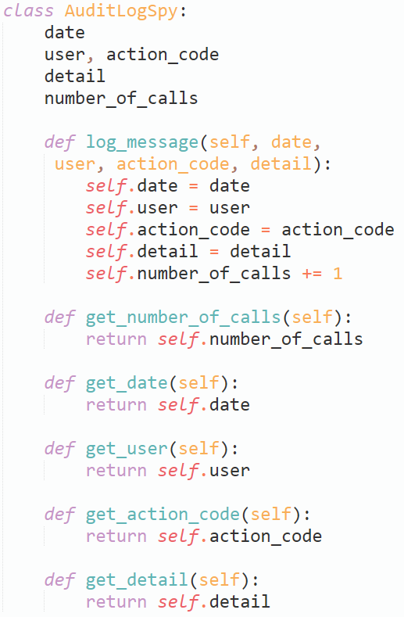
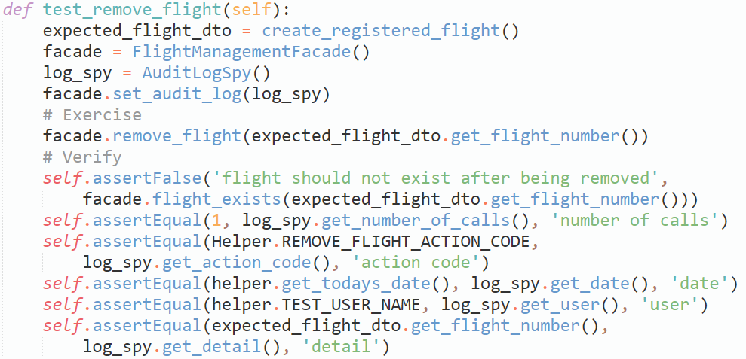
Solution with a test spy
Test spy implementation
Test spy installation
Verify direct output
Verify indirect outputs

Slide 22
Fake object
A replacement for a DOC that implements the same functionality of that DOC but in a much simpler way
Typical usage: when the use of the actual DOC would make the tests slow (e.g., database or web service )
It can be also used when a DOC is not available yet
Fake objects vs test stubs:
Stubs do not actually implement DOCs' functionality---they just returns hard-coded or configured values
Fake objects do implement DOCs' functionality in a lighter-weight way

Slide 23
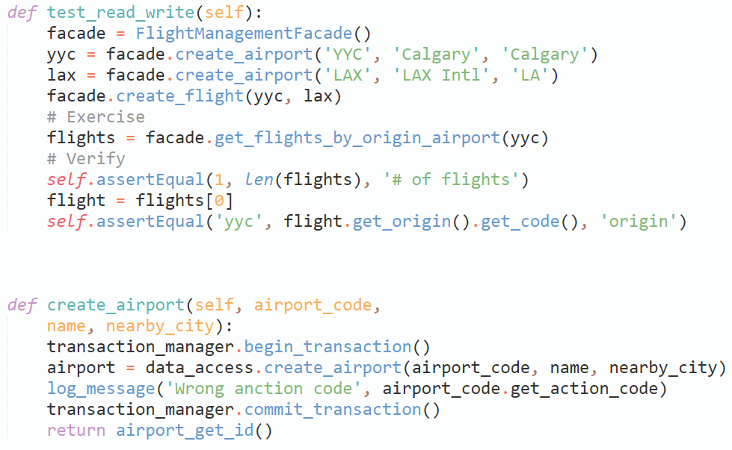
Motivating example for a fake object
It calls create_airport (twice), which calls the data access layer so causing the test to slow down

Slide 24
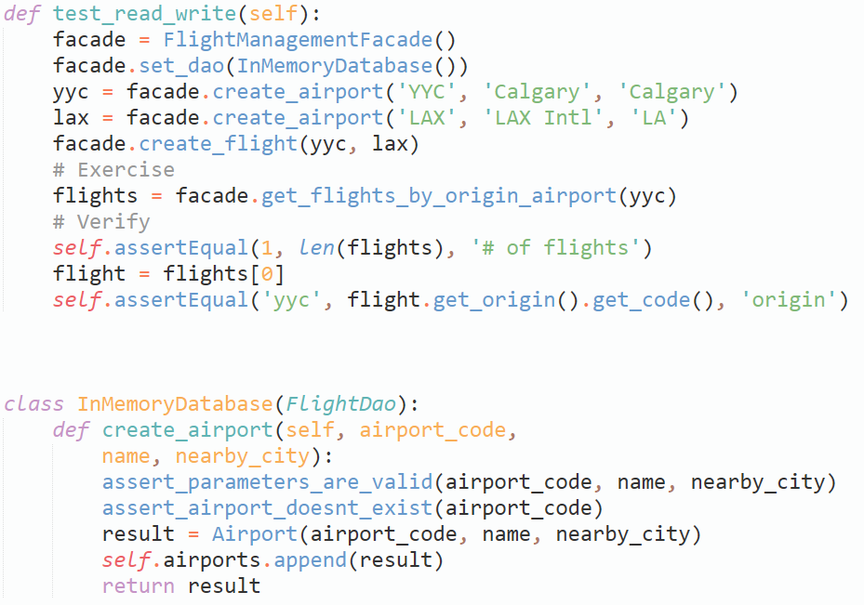
Solution with a fake object
Fake object installation
Fake object implementation---it is an in-memory database that is faster than the actual DOC

Slide 25
Mock object
A replacement for a DOC that provides a dummy implementation for that DOC and enables both control of the indirect inputs and observation of the indirect outputs
It can be seen as a more sophisticated test spy with further capabilities
Dis/similarities with test stub and spy:
Like a test stub, a mock object enables the control of the indirect inputs
Like a test spy, a mock object enables the observation of the indirect outputs
Unlike a test spy, when comparing actual calls received with the previously defined expectations, it performs assertions and fails the test on behalf of the test method

Slide 26
Mock object
Two variants of mock objects:
Strict mock object---it fails the test if correct calls are received in a different order than was specified
Lenient mock object---it tolerates out-of-order calls (some lenient mock objects tolerate or even ignore unexpected calls or missed calls)
It can be implemented in either an hard-coded or configurable way

Slide 27
Motivating example for a mock object
You should remember this example, it is the same as the test spy

Slide 28
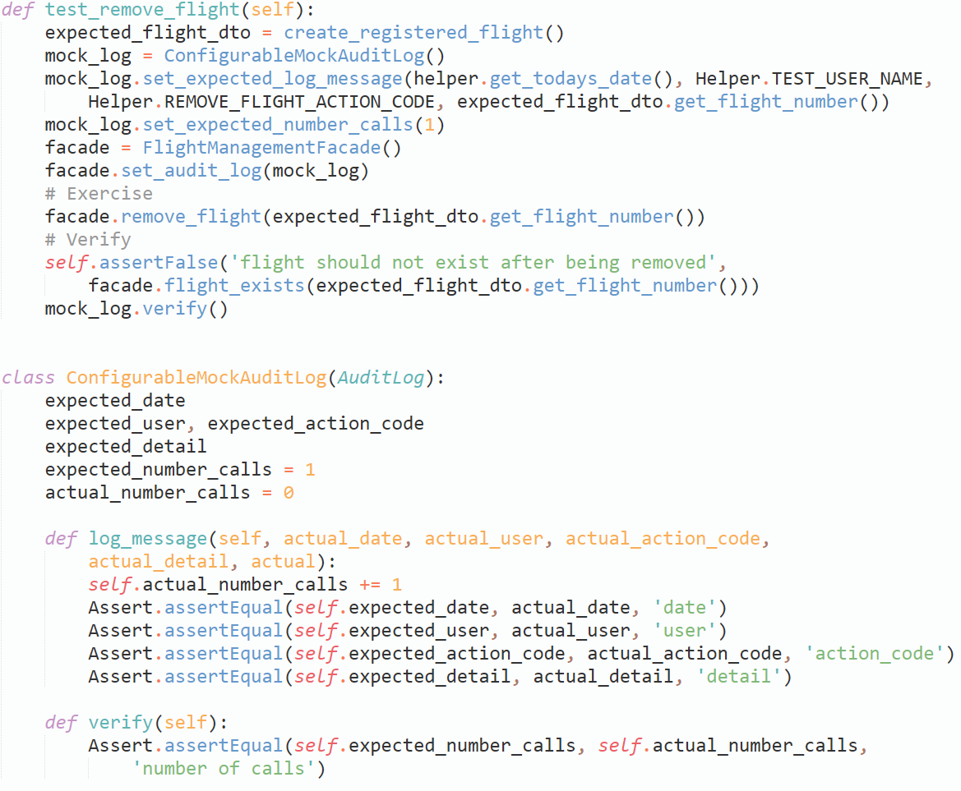
Solution with a mock object
Mock object installation
Verify direct output
Mock object implementation
It verifies indirect outputs when it is called
It verifies the call to logMessage() was actually made

Slide 29
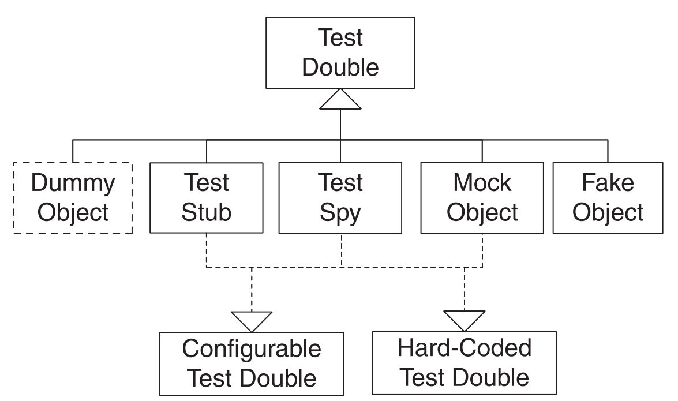
Summary of test doubles

Slide 30
Test code refactoring
The previous motivating examples can be seen as test anti-patterns
If a test method looks like one the motivating example, then you should start thinking to refactor that method using the corresponding suggested solutions (e.g., fake object, test spy, etc.)

Slide 31
Implementing test doubles
So far we have seen how to manually implement the various types of test double.
Some frameworks (i.e. unittest) provide some tools to facilitate this process.

Slide 32
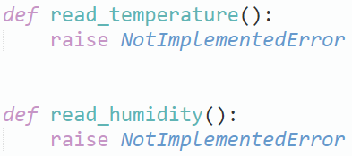
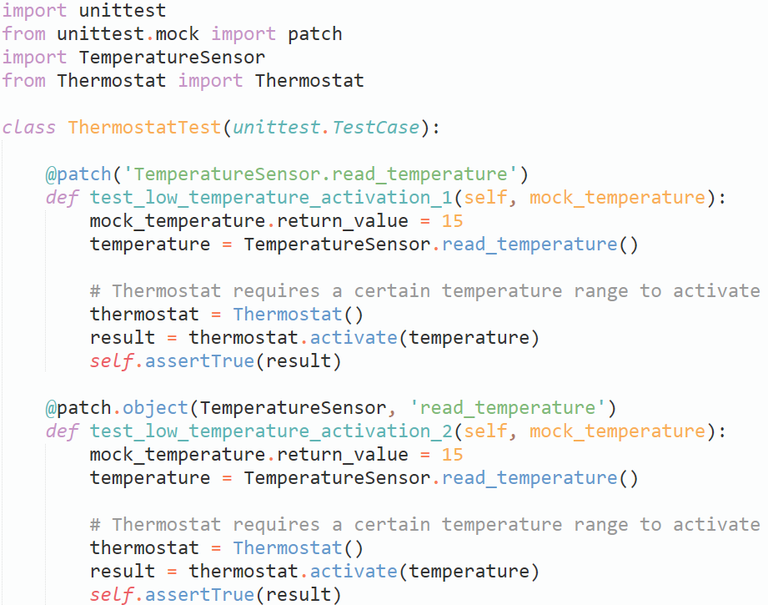
Mocking with unittest
Functions have not yet been implemented
Path of the function to mock
Mock object parameter
Setting the return value for the mocked function
Alternative syntax

Slide 33
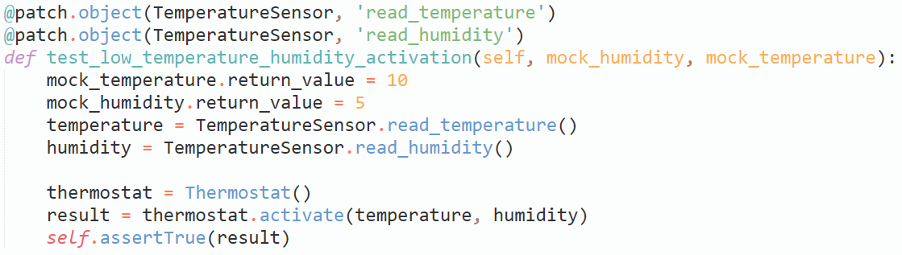
Mocking with unittest
IMPORTANT: when using multiple decorators on your test method, the mapping on the parameters works backwards.
Reversed order

Slide 34
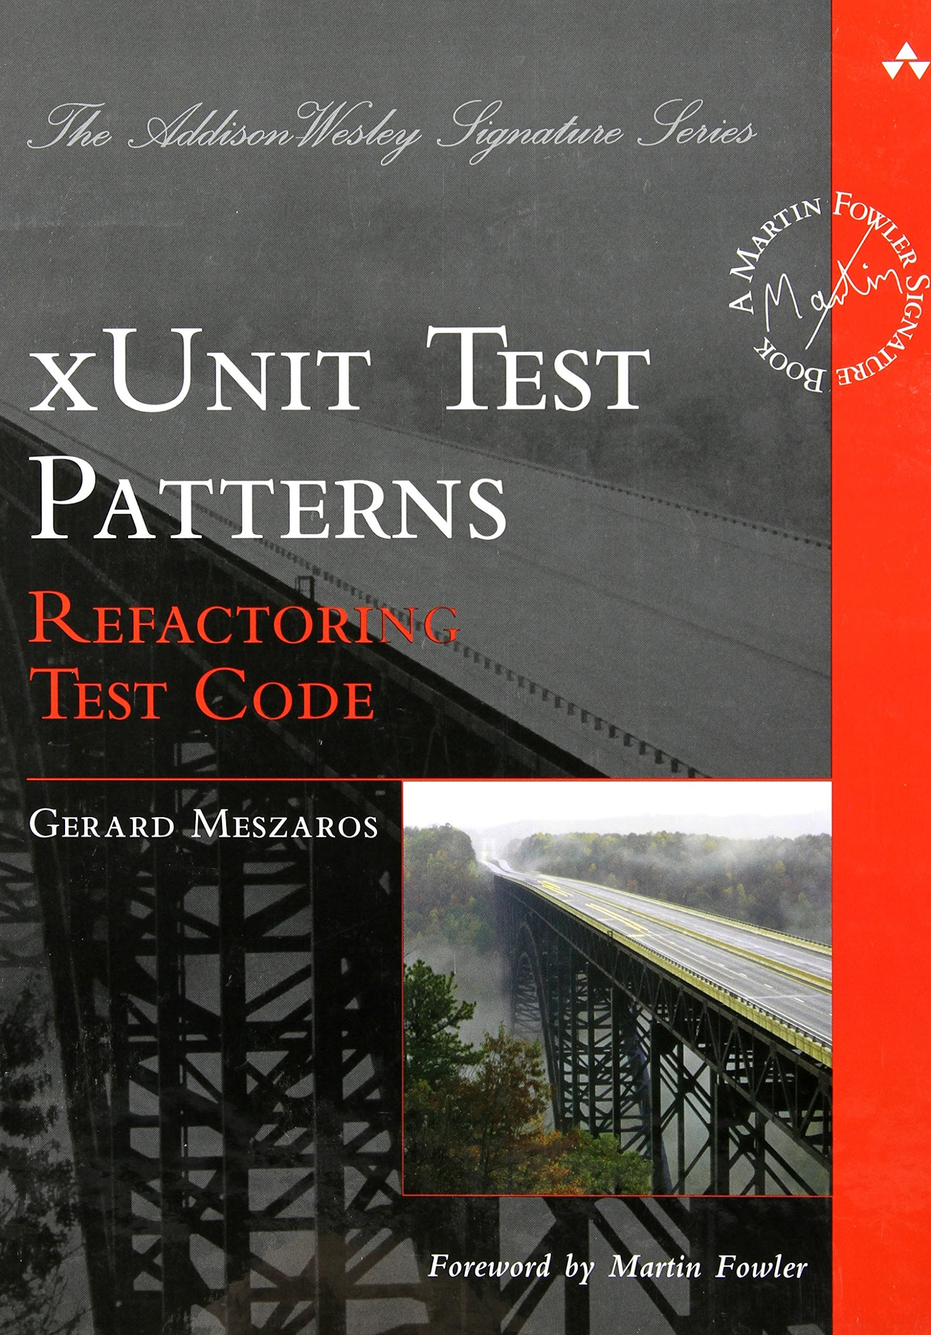
Reference book

